Slide 1
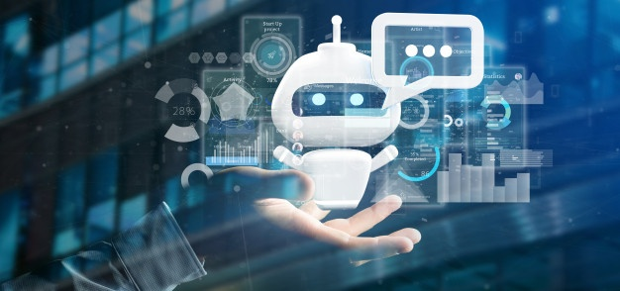
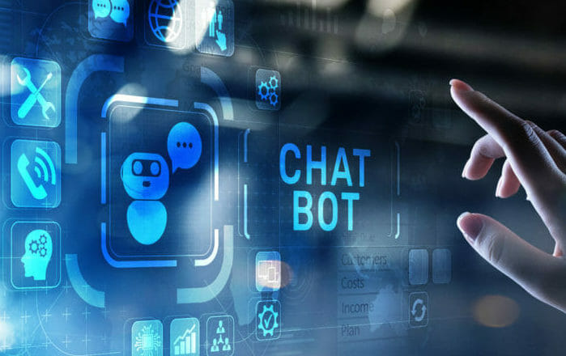
IDEA! - AI CHATBOT CLI and UI
A chatbot is a AI computer software program that's designed to simulate human conversation.
Users communicate with these tools using a chat interface or via voice, just like they would converse with another person
Usa Cases: commerce (e-commerce via chat), education, entertainment, finance, health, news, and productivity.

Slide 2
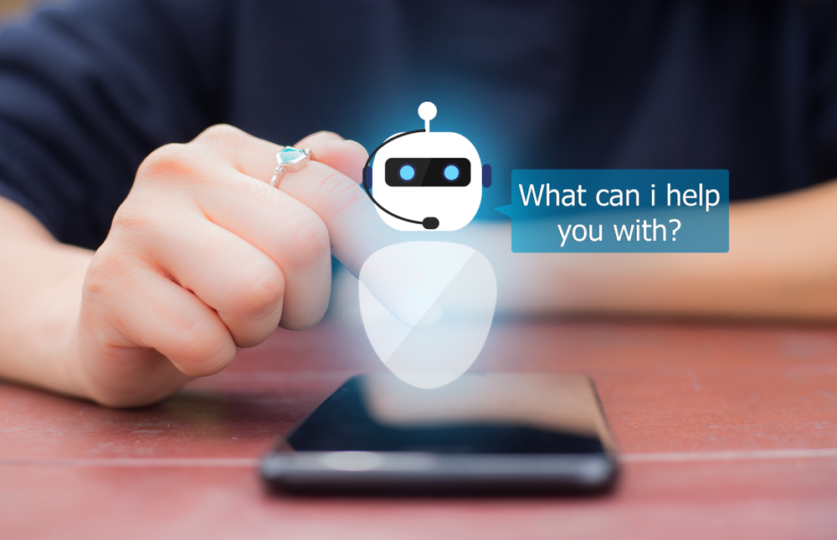
Why AI CHATBOT?
Manage tedious product configuration
Reduce human intervention
Automated Email Sending
Quick Technical Support ticket resolution
TAC technotes for frequent issues.
PSIRT vulnerabilities impacting module
for quicker TAC communication

Slide 3
How do we secure ChatBot technology?
Two Factor Authentication
Use a Web Application Firewall
User IDs an
End To End Encryption
Authentication Timeouts
Messages that Self-Destruct

Slide 4
AI CHATBOT - CLI
Components Required:
Numpy
Nltk
Tensorflow
tfLearn
Json File
Python >=2.6

Slide 5
AI CHATBOT CLI - Flow Diagram
Json Intents
(Tags + Patterns + Responses)
Data Extraction
NLTK Word Tokenizer
(Pattern + Tag)
Preprocess Data
(Stemming + BOW)
Automated Actions
Output Intent Response
Model Prediction
Model Loading
Model Training
(DNN)
User Input

Slide 6
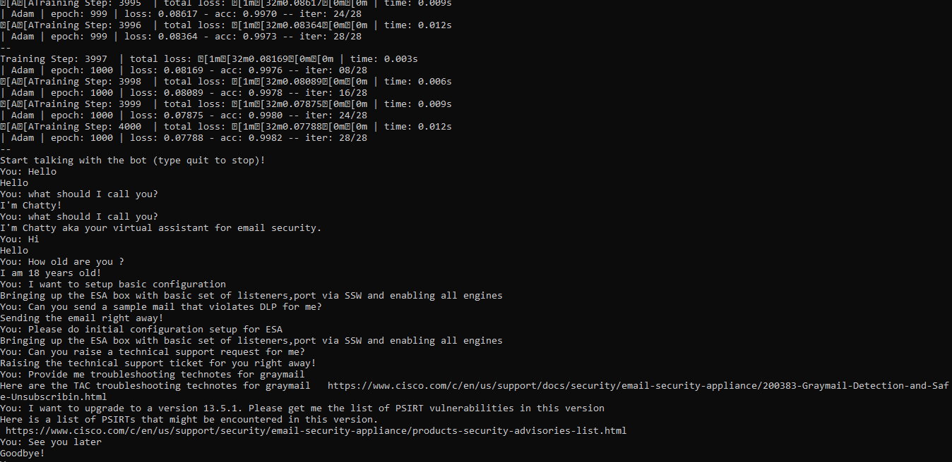
AI CHATBOT - CLI Demo

Slide 7
Common AI Techniques used in ChatBots
Natural Language Processing
Named Entity Recognitions
Machine Learning
Augmentation Capacities
Personality AI
Conversational AI
Problem Solving

Slide 8
AI CHATBOT Development Frameworks - UI
Microsoft Bot Framework
Rasa
Wit.ai
Dialog Flow
IBM Watson
Amazon Lex

Slide 9
AI CHATBOT - UI Angular with Dialog Flow
Google’s Dialog Flow for Chat Interface
Agents
Intents
Entities
Annotations
Fulfillment
These agents will be integrated to Angular to perform automated configuration actions,online help,etc via Web Hooks with help of Node Js

Slide 10
AI CHATBOT - UI Angular with Dialog Flow - Demo

Slide 11
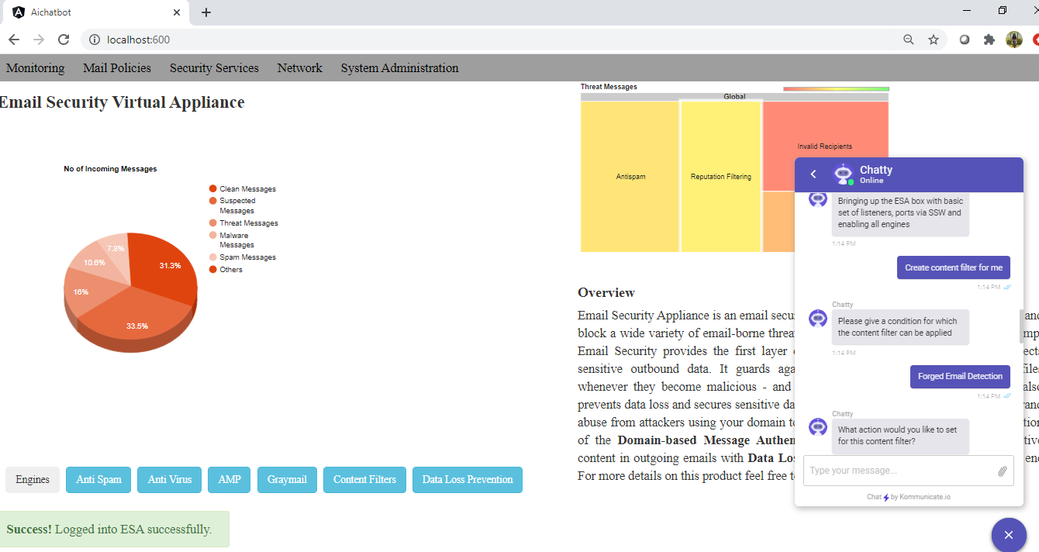
Reena B Thomas

Slide 12
Thank You

